Slide 1
FIlm ProductIon DBMS
Melik koçhan 22207971
Emirkan Aydoğan 22109949
Helin gül 22208055
Fatih Mehmet YILMAZ 22110075

Slide 2
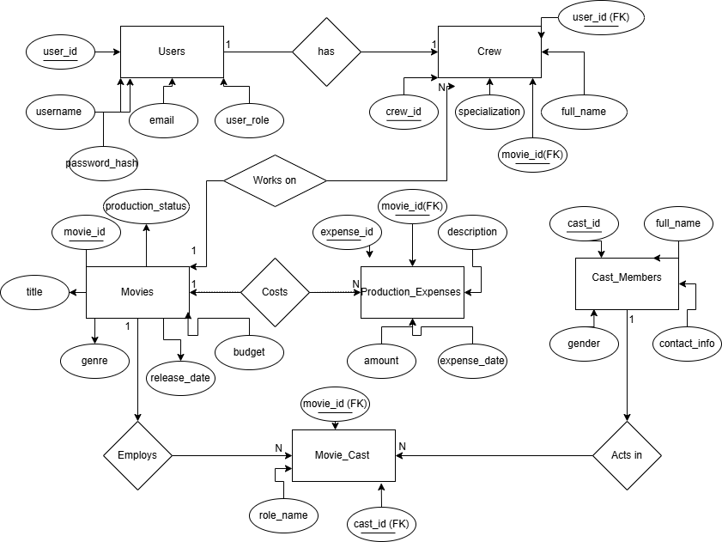
ER DIAGRAM

Slide 3

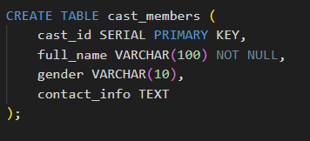
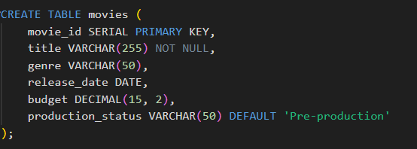



TABLES

Slide 4







Slide 5







Slide 6

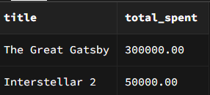

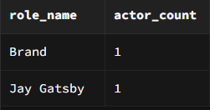



Slide 7




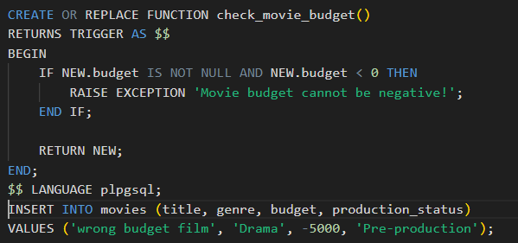


Slide 8
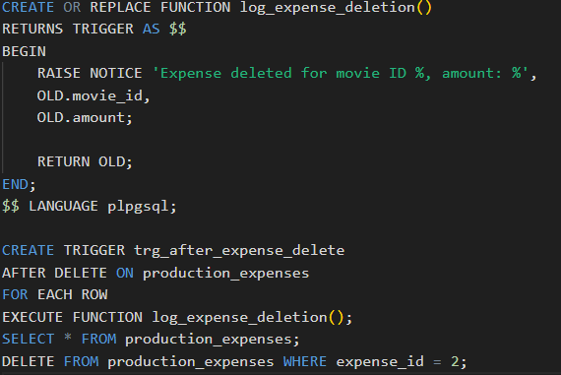


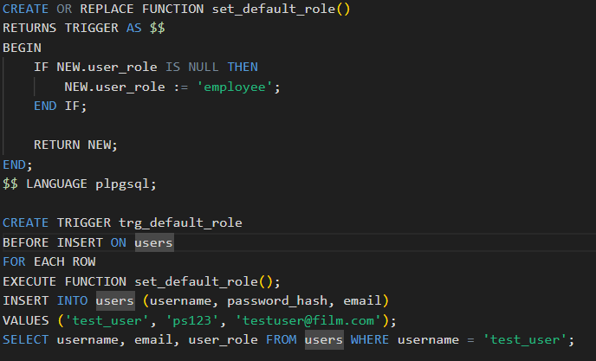

SELECT * FROM production_expenses;
DELETE FROM production_expenses WHERE expense_id = 2;

Slide 9
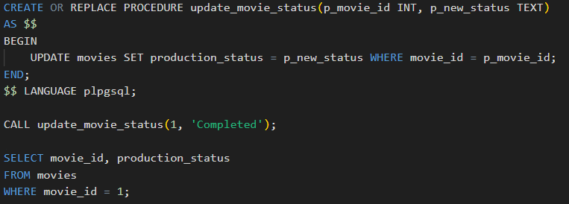


Slide 10
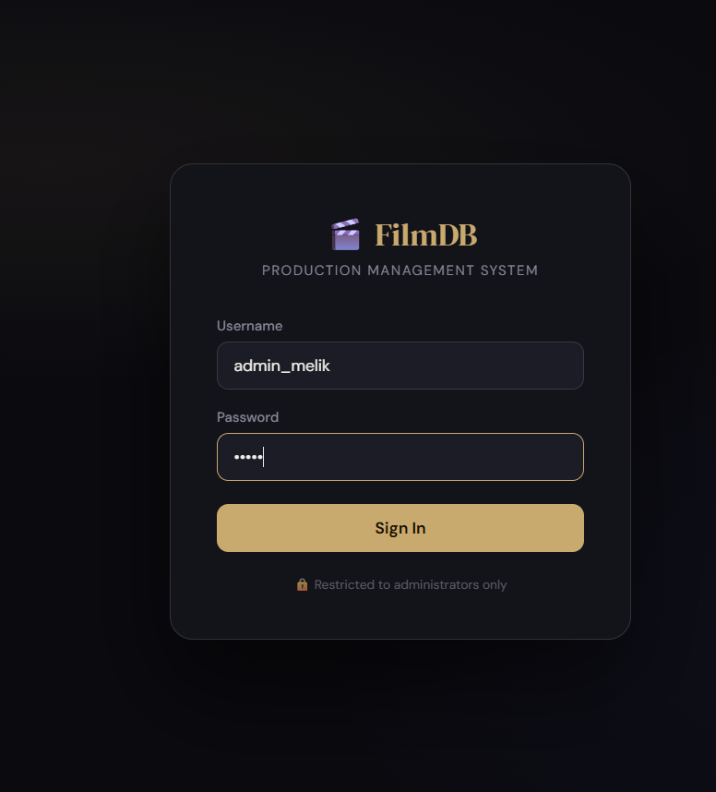
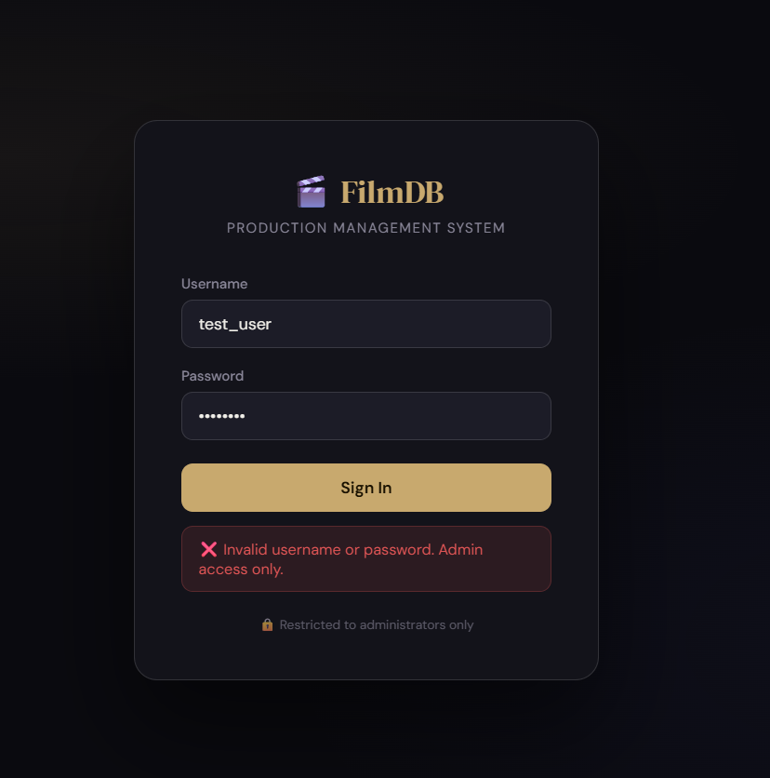
Logın
Admin
Other users

Slide 11

DB CONNECTİON
This section contains the necessary input fields to connect our database to the website. We fetch the data from Supabase to our site using the API values

Slide 12
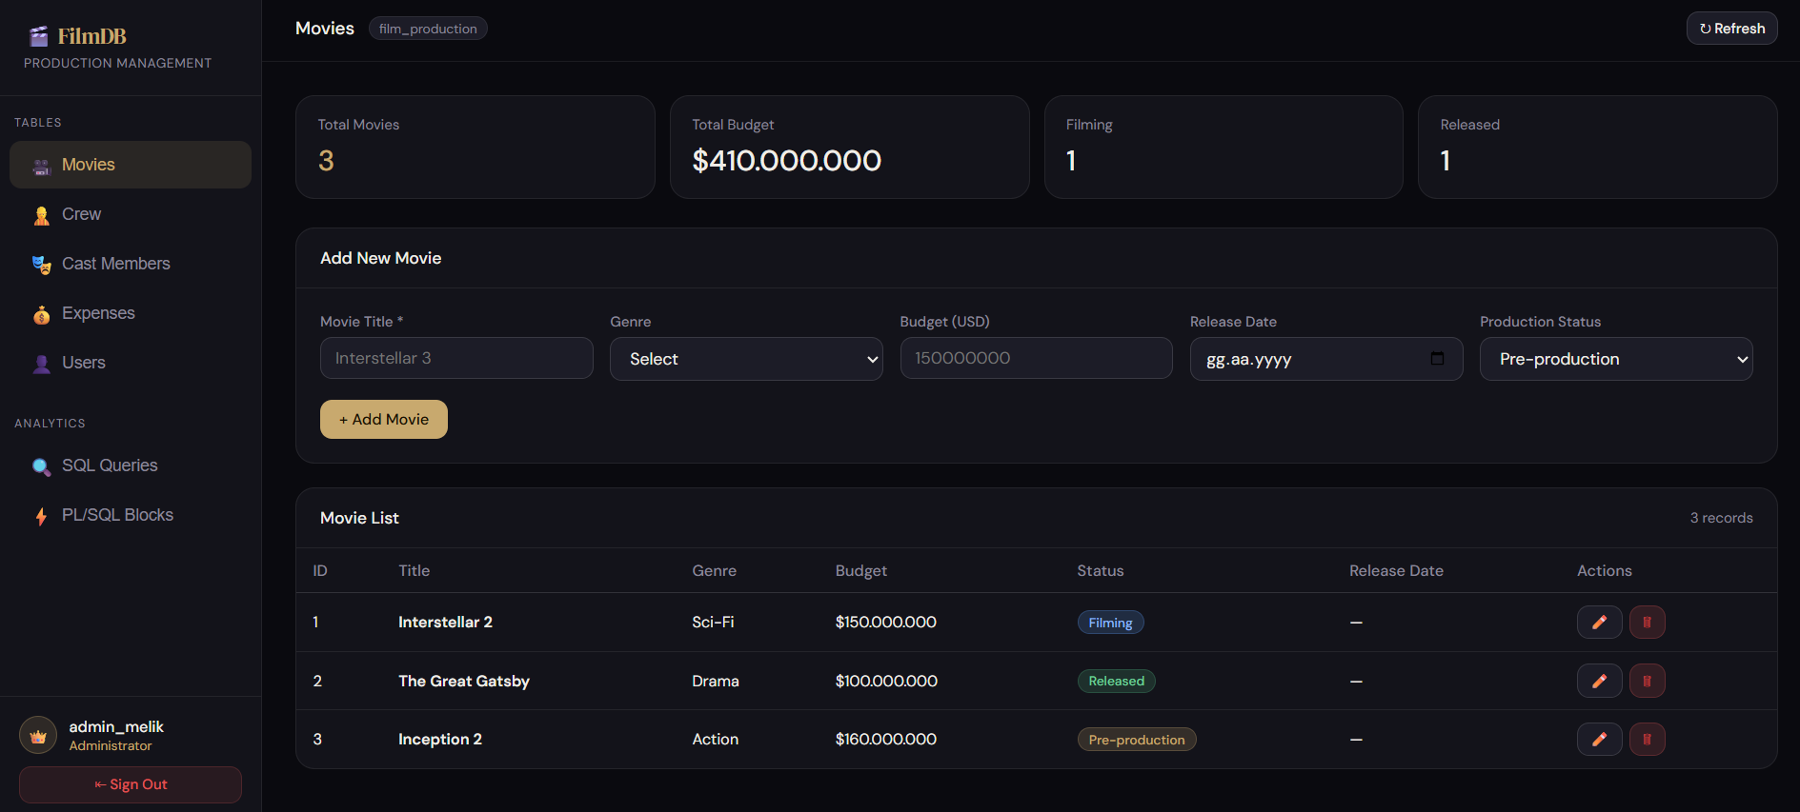
Maın page

Slide 13
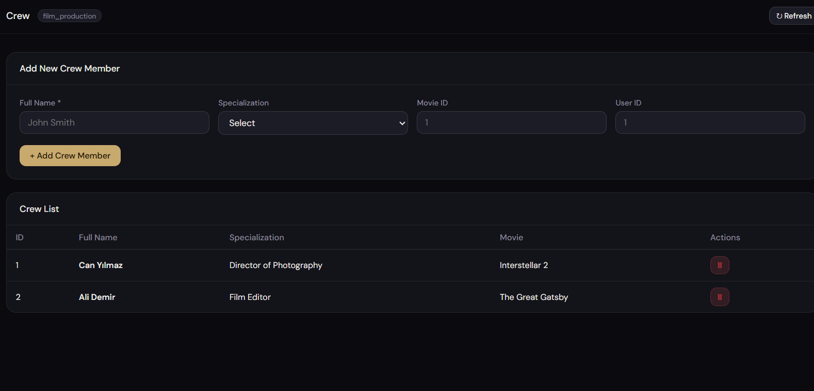
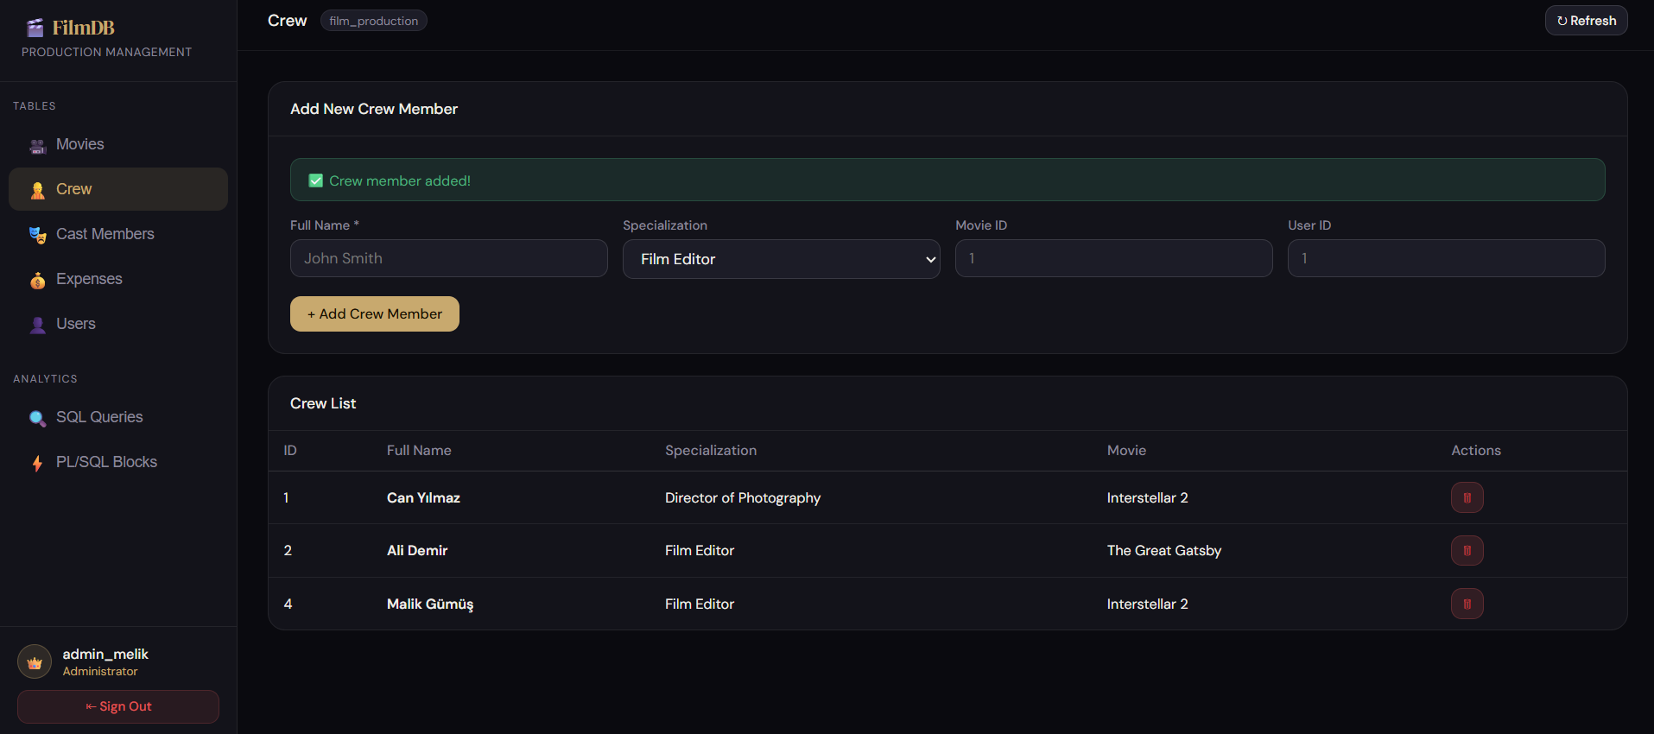
As shown here, we add a new user and receive a message confirming the creation of the new user
BEFORE
AFTER

Slide 14
THANKS FOR LISTENING
Github link: https://github.com/Melikkochan/Film-Production-DBMS

